Slide 1
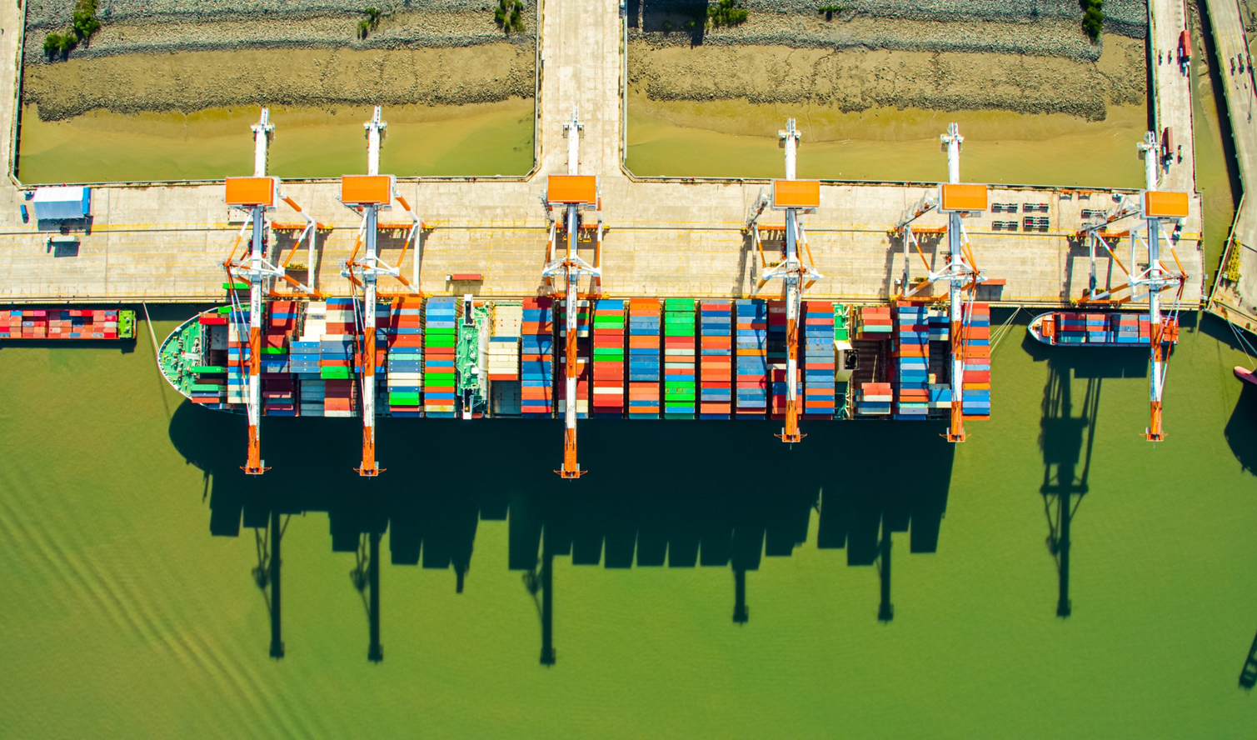
A member of Saigon Newport Corporation
WELCOME
Ba Ria Vung Tau, 2023

Slide 2
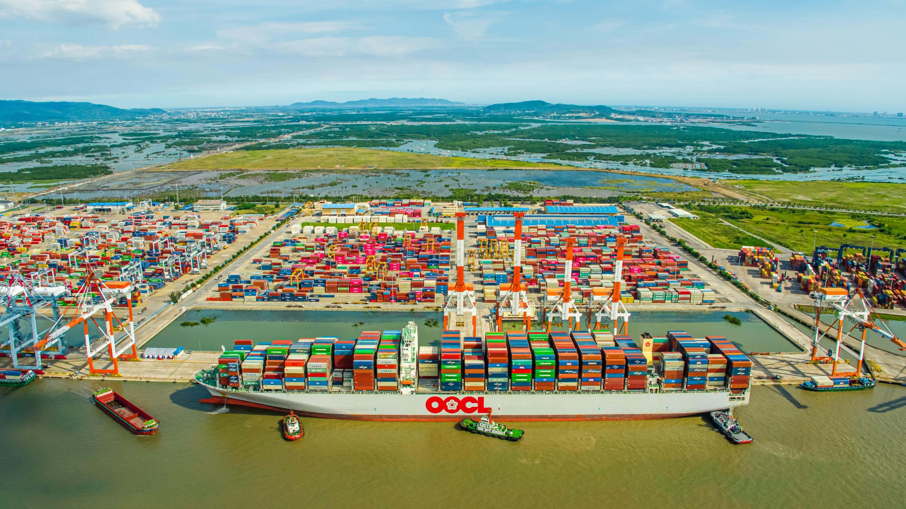
TAN CANG – CAI MEP THI VAI TERMINAL ONE-MEMBER LLC
ADDRESS:
Head office: Tan Loc commune, Phuoc Hoa Ward, Phu My Town, Ba Ria Vung Tau Province.
Tel: (+84)64.393.8778 Fax: (+84) 64.393.8777
Email: tctt@saigonnewport.com.vn
Hotline (Operation): 0962.353.500

Slide 3
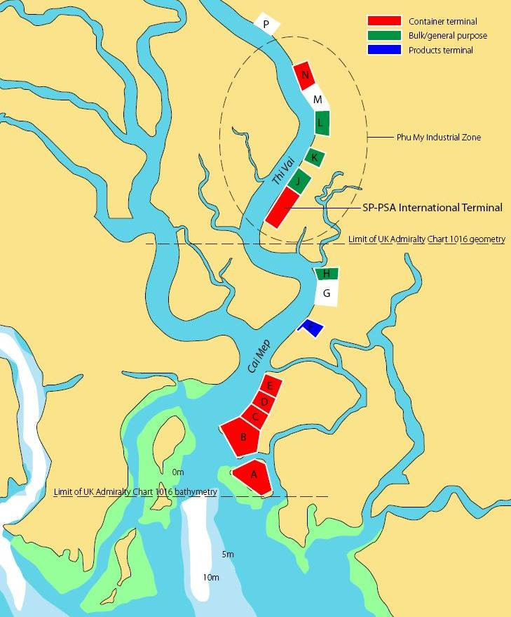
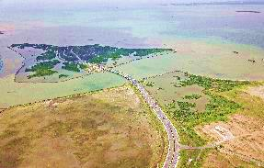
Cai Mep-Thi Vai Area – Port Operators
N
 | Terminal | Draft | Operation time | Weekly Call | Shareholders
N | SITV | 12 m | 08/2010 | 0 | Hutchison Ports, SICC
I | SP-PSA | 12 m | 05/2009 | 0 | Saigon Port, Vinaline, PSA
H | TCCT | 14 m | 06/2009 | 0 | SNP
G | TCIT | 14 m | 01/2011 | 9 | SNP, MOL, HJT, WHL
E | CMIT | 14 m | 04/2011 | 6 | Saigon Port, Vinaline, APMT
D | TCTT | 14 m | Q1/2014 | 8 | SNP
C | SSIT | 14 m | 08/2018 | 5 | Saigon Port, Vinaline, SSA
B | Gemalink | 15 m | 01/2021 |  | Gemadept, CMA- CGM
A | Cai Mep down-stream | N/A | Waiting for permission
N
K
-12 m
J
I
I
H
H
G
-14m
F
E
D
C
B
A

Slide 4
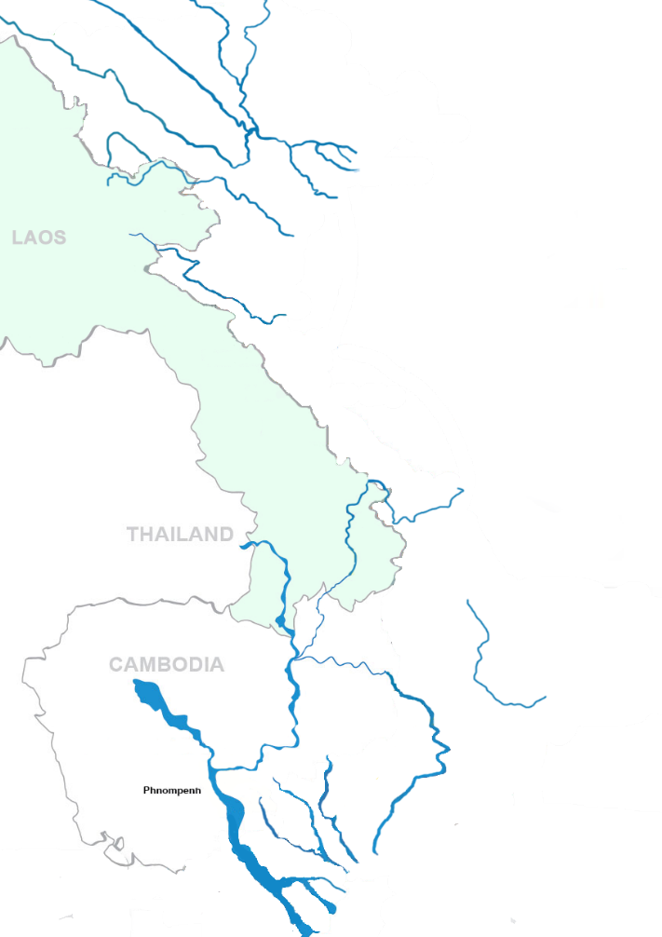
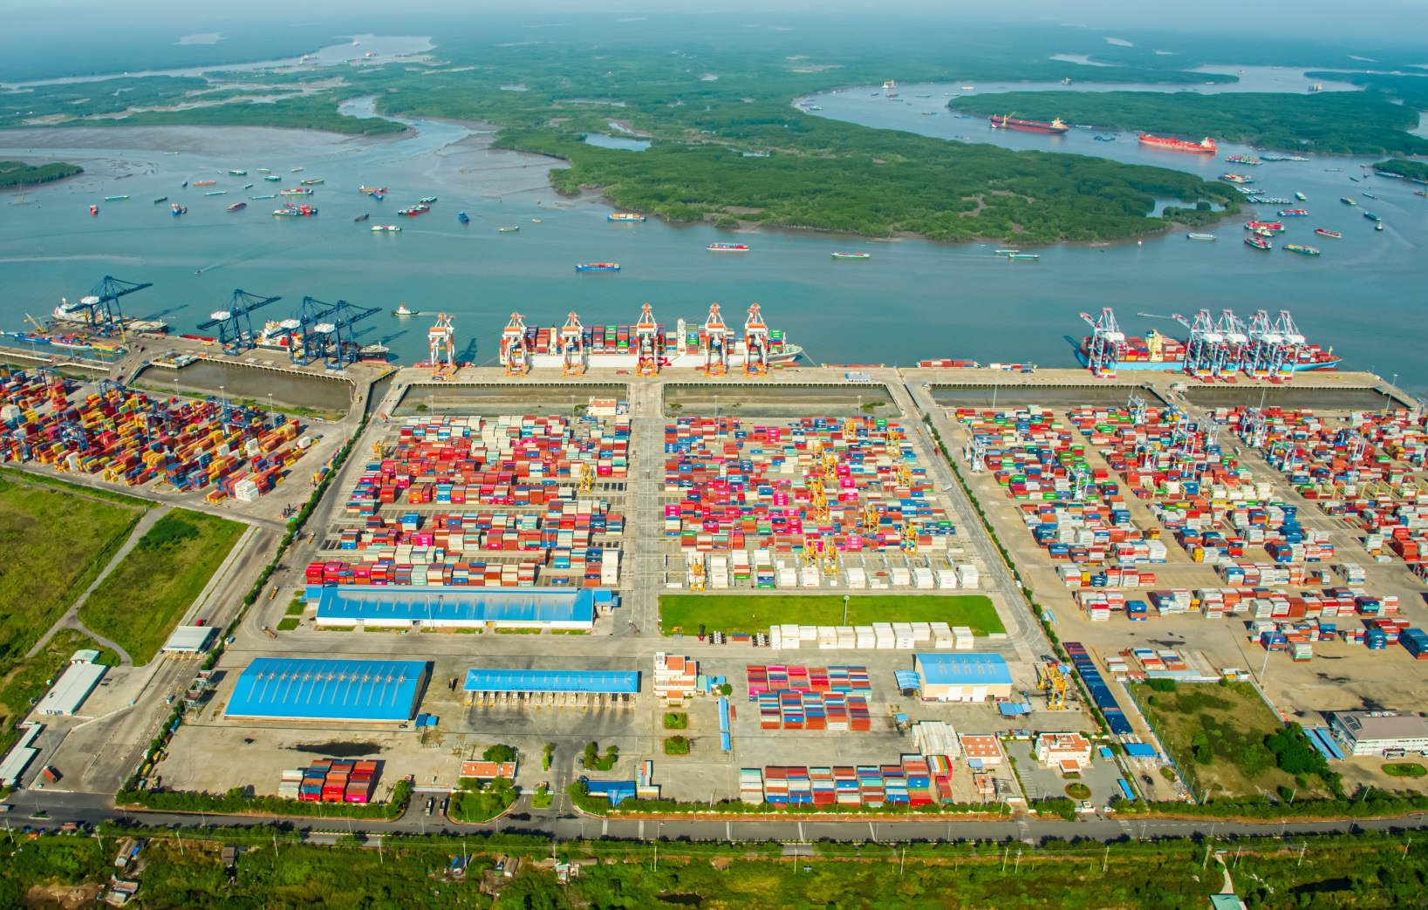
TC – 128 TML
TC – 189 TML
TC-HICT
TCCL, TCHP
TC-Cai Cui TML
TCTT
Location address: 10°30'33'N 107°00'26'E

Slide 5
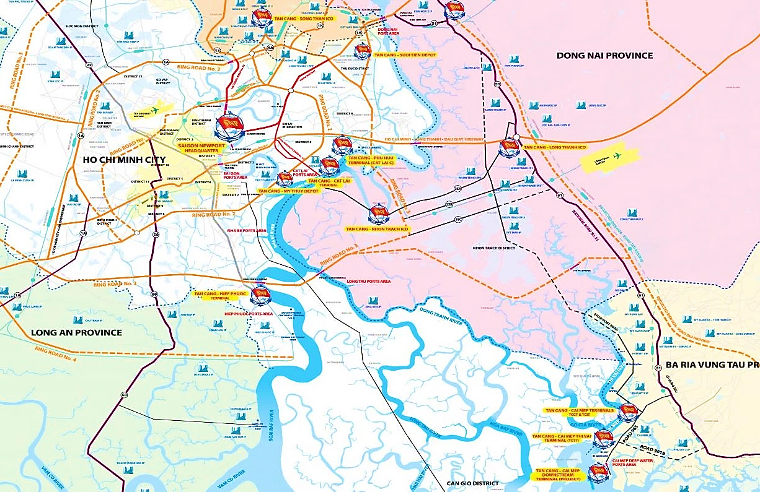
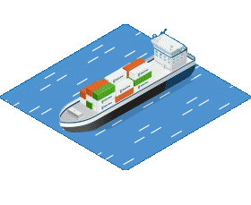
Tan Cang – Song Than ICD
57 60
Tan Cang – Long Binh ICD
Tan Cang – Suoi Tien Depot
54
Tan Cang – Hiep Luc Depot
Tan Cang – Cat Lai TML
55
Tan Cang – My Thuy Depot
65 45
Tan Cang – Nhon Trach ICD
51 72
Tan Cang – Hiep Phuoc TML
Connection with SNP’s system
By water (km) By road (km)
TCTT

Slide 6
Connection with industrial parks, manufacturing zone in the South East of VN
Bình Dương
Đồng Nai
TP. HCM
Long An
BRVT
TCTT
Tiền Giang

Slide 7
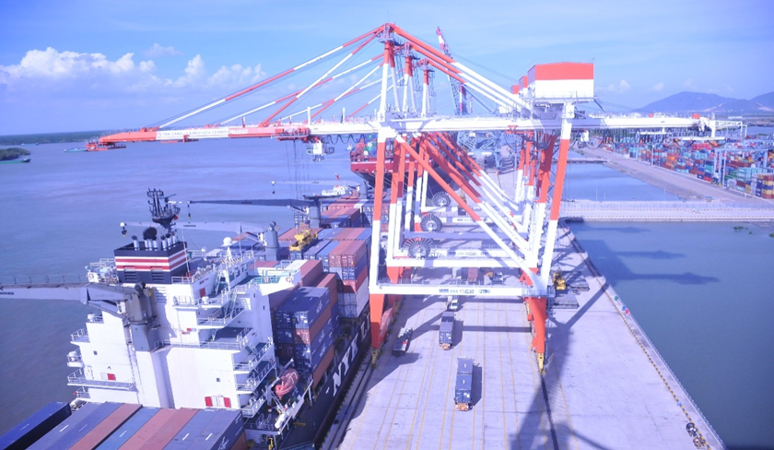
Market share of imported/exported containers of TCTT
TCTT %
TCIT & TCCT
OTHERS %
2021
2022

Slide 8
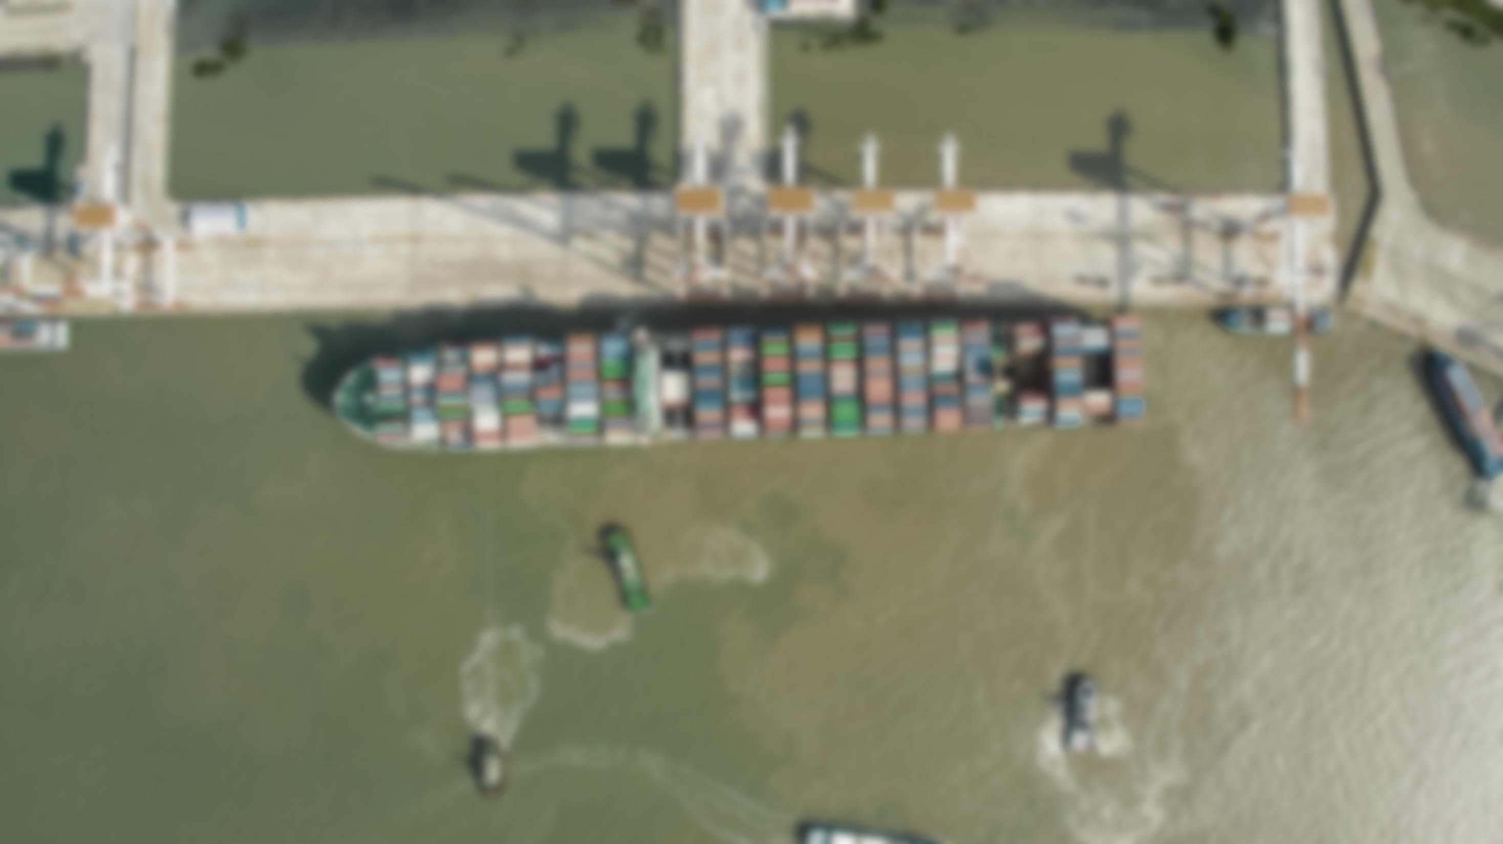

Slide 9
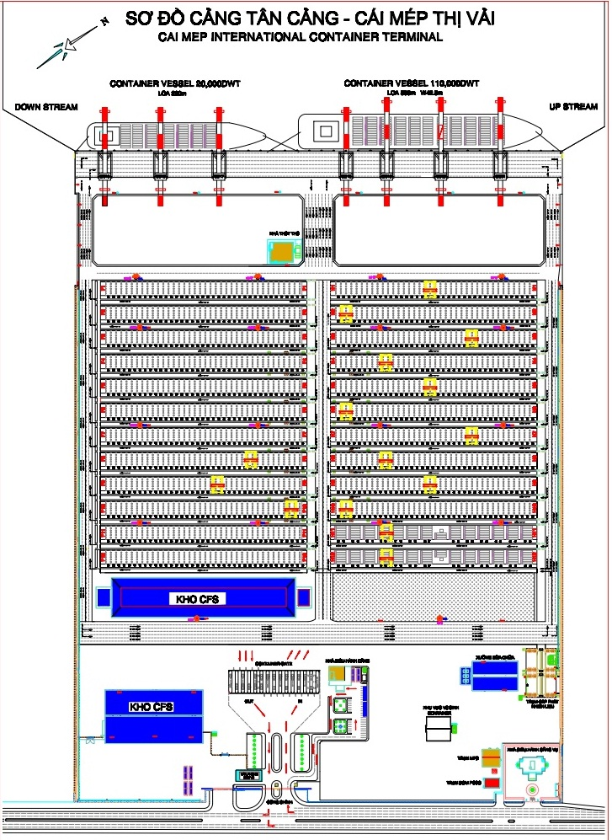
St 965

Slide 10
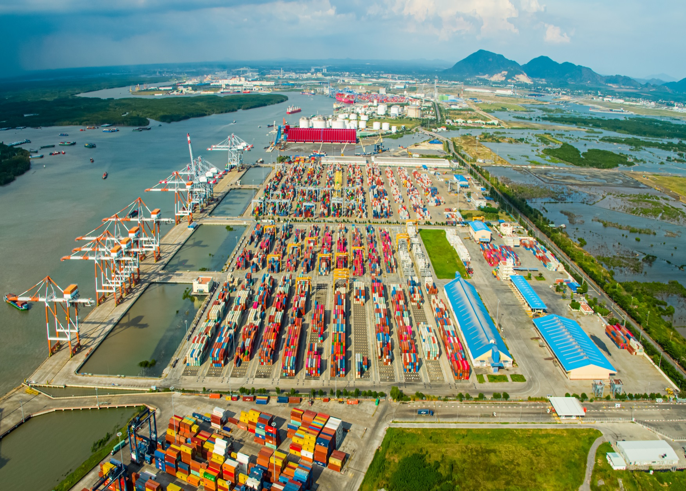
Equipment
Terminal Specifications
Total Area | 48 ha
Terminal capacity | 1,500,000 TEUs/year
Max. vessel size | 160,000 DWT (~ 14,000 TEU) and over
Berth Length | 600 m (02 berths)
Channel chart datum | -14 m (tidal range: 0,5 – 4,1)
Notes:
2 kho hàng sản tổng diện tích 16.400m²

Slide 11
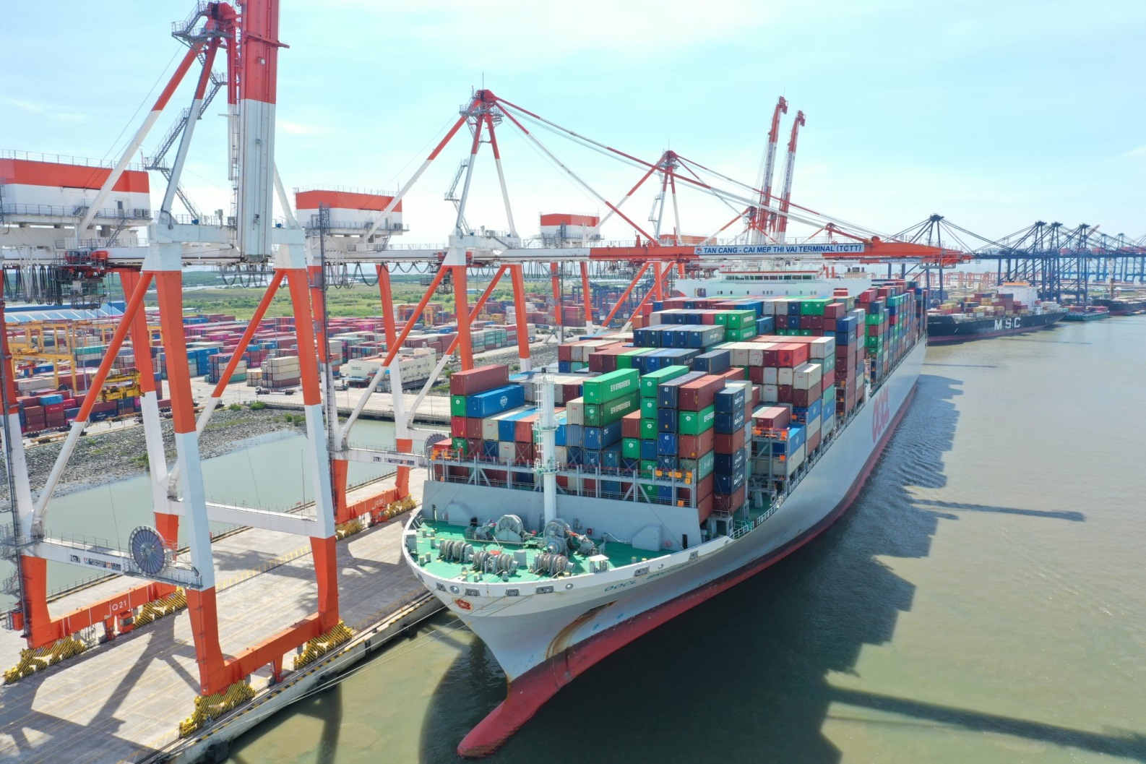
Equipment
Wharf:
Type of wharf : piled construction
Total length of wharf : 600 m
Number of berth : 02
Berth depth alongside:16.1m below CDL
Width of apron : 55 m
Crown height : +5m above CDL
Height water line(HWL) : + 3.97 m
Low water line (LWL) : +0.58 m
CDL (Chart datum line) : ± 0 m
Width of channel : 310 m.
Radius of vessel turning basin : 400m
Size ship: Up to 160,000 DWT.
Max Cap.: 1,500,000 TEUs/year.

Slide 12
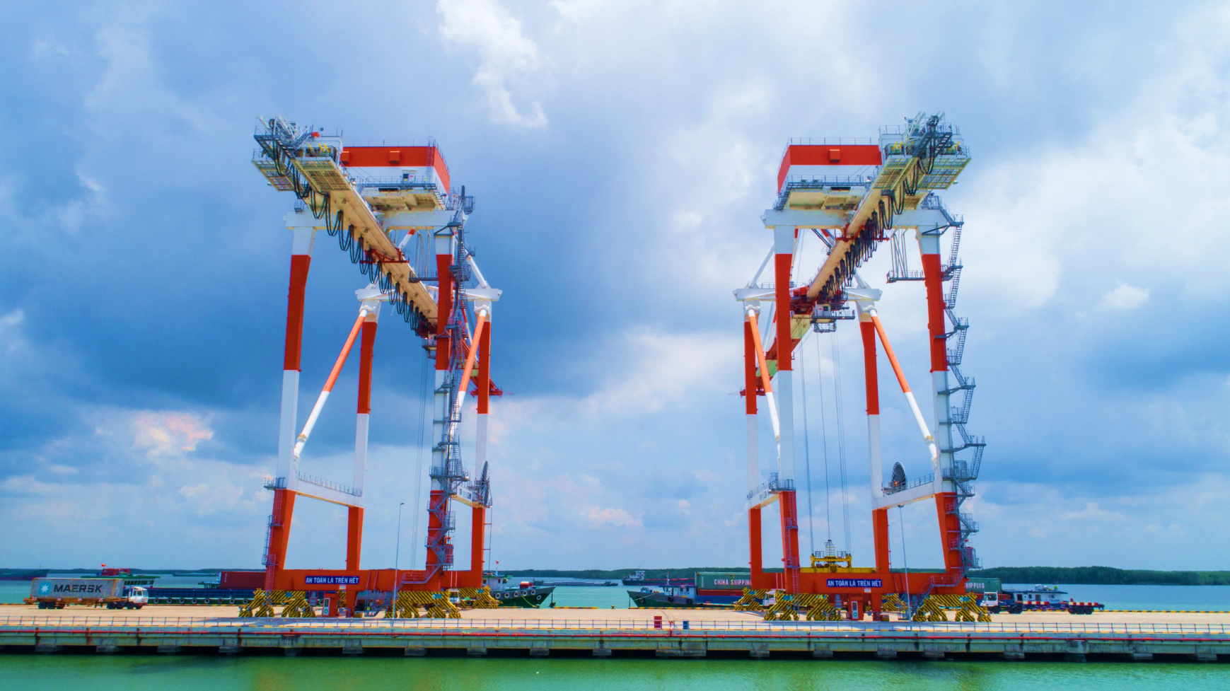
Equipment
07 Ship to Shore Container Cranes (Mitsui)
04 Post Panamax Cranes: Lifting capacity of 50T, Out reach of 50m
03 Super Post Panamax Cranes: Lifting capacity of 65T, Out reach of 65m

Slide 13
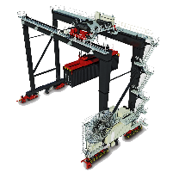
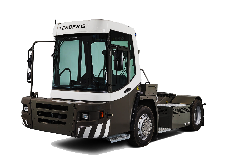
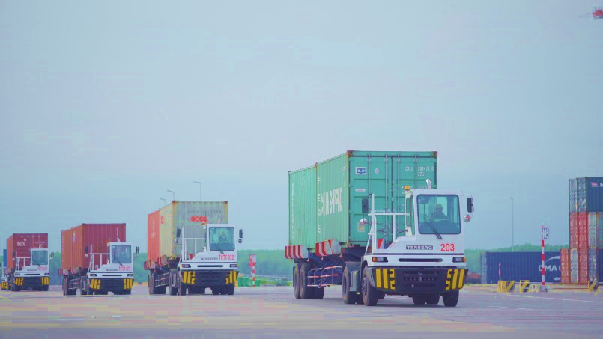
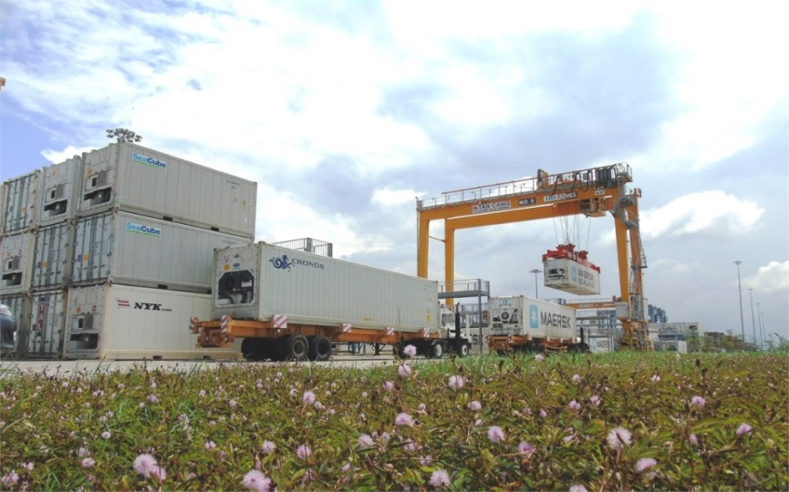
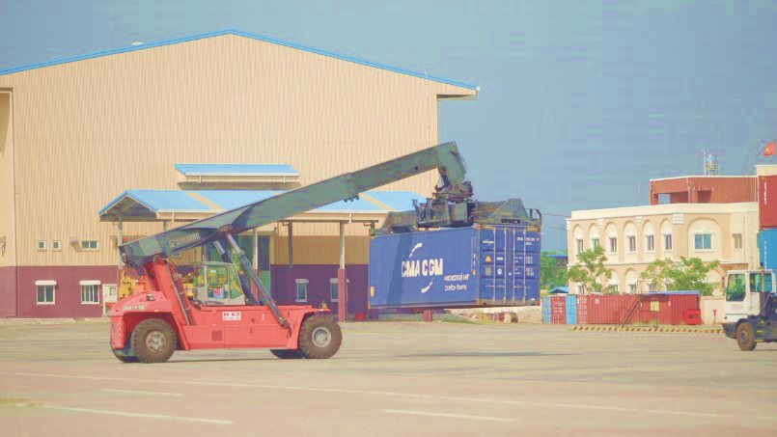
Equipment
15 RTGs
38 Trucks
01 Reach stacker
02 Fork Lifts
486 Referee Plug

Slide 14
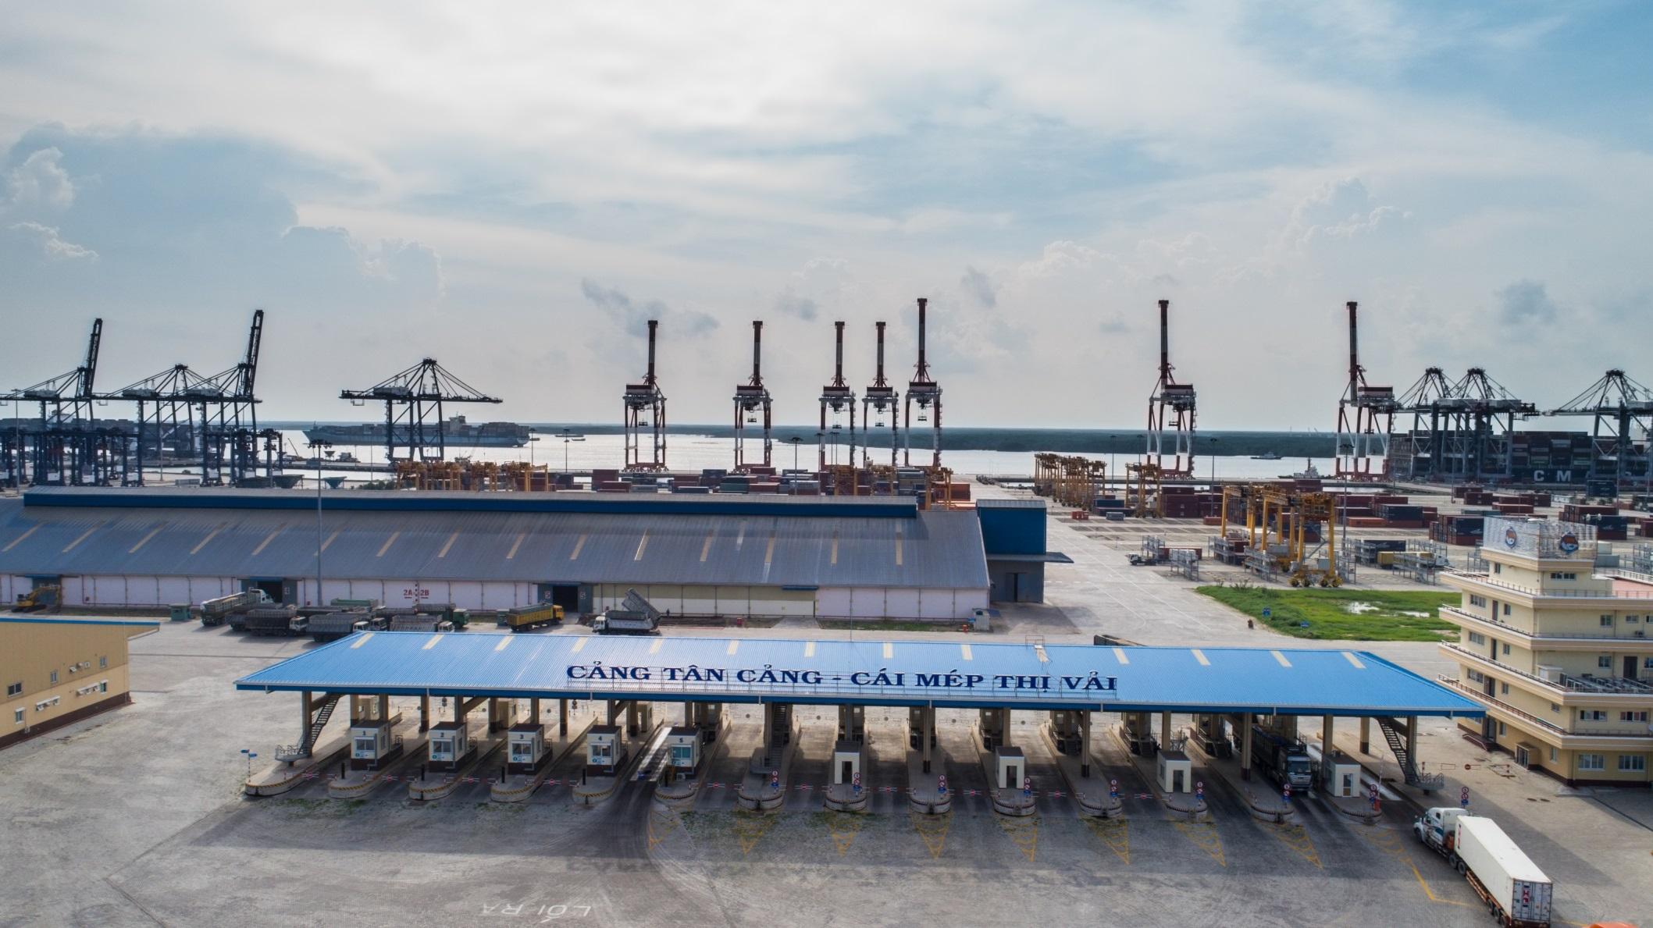
CONTAINER GATE
Equipment
- 14 lanes : 09 gate in + 05 gate out.
- 03 bridge weight 80T

Slide 15
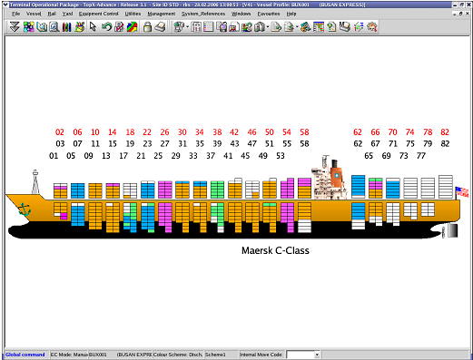
Technology
Mordern Operating System
TOPX (Terminal Operation Package System) –by RBS (Australia).
Management, storage and container statistic provision.
Advanced interface with customers and related parties
Revenue and Profit management for reliability and trust.

Slide 16
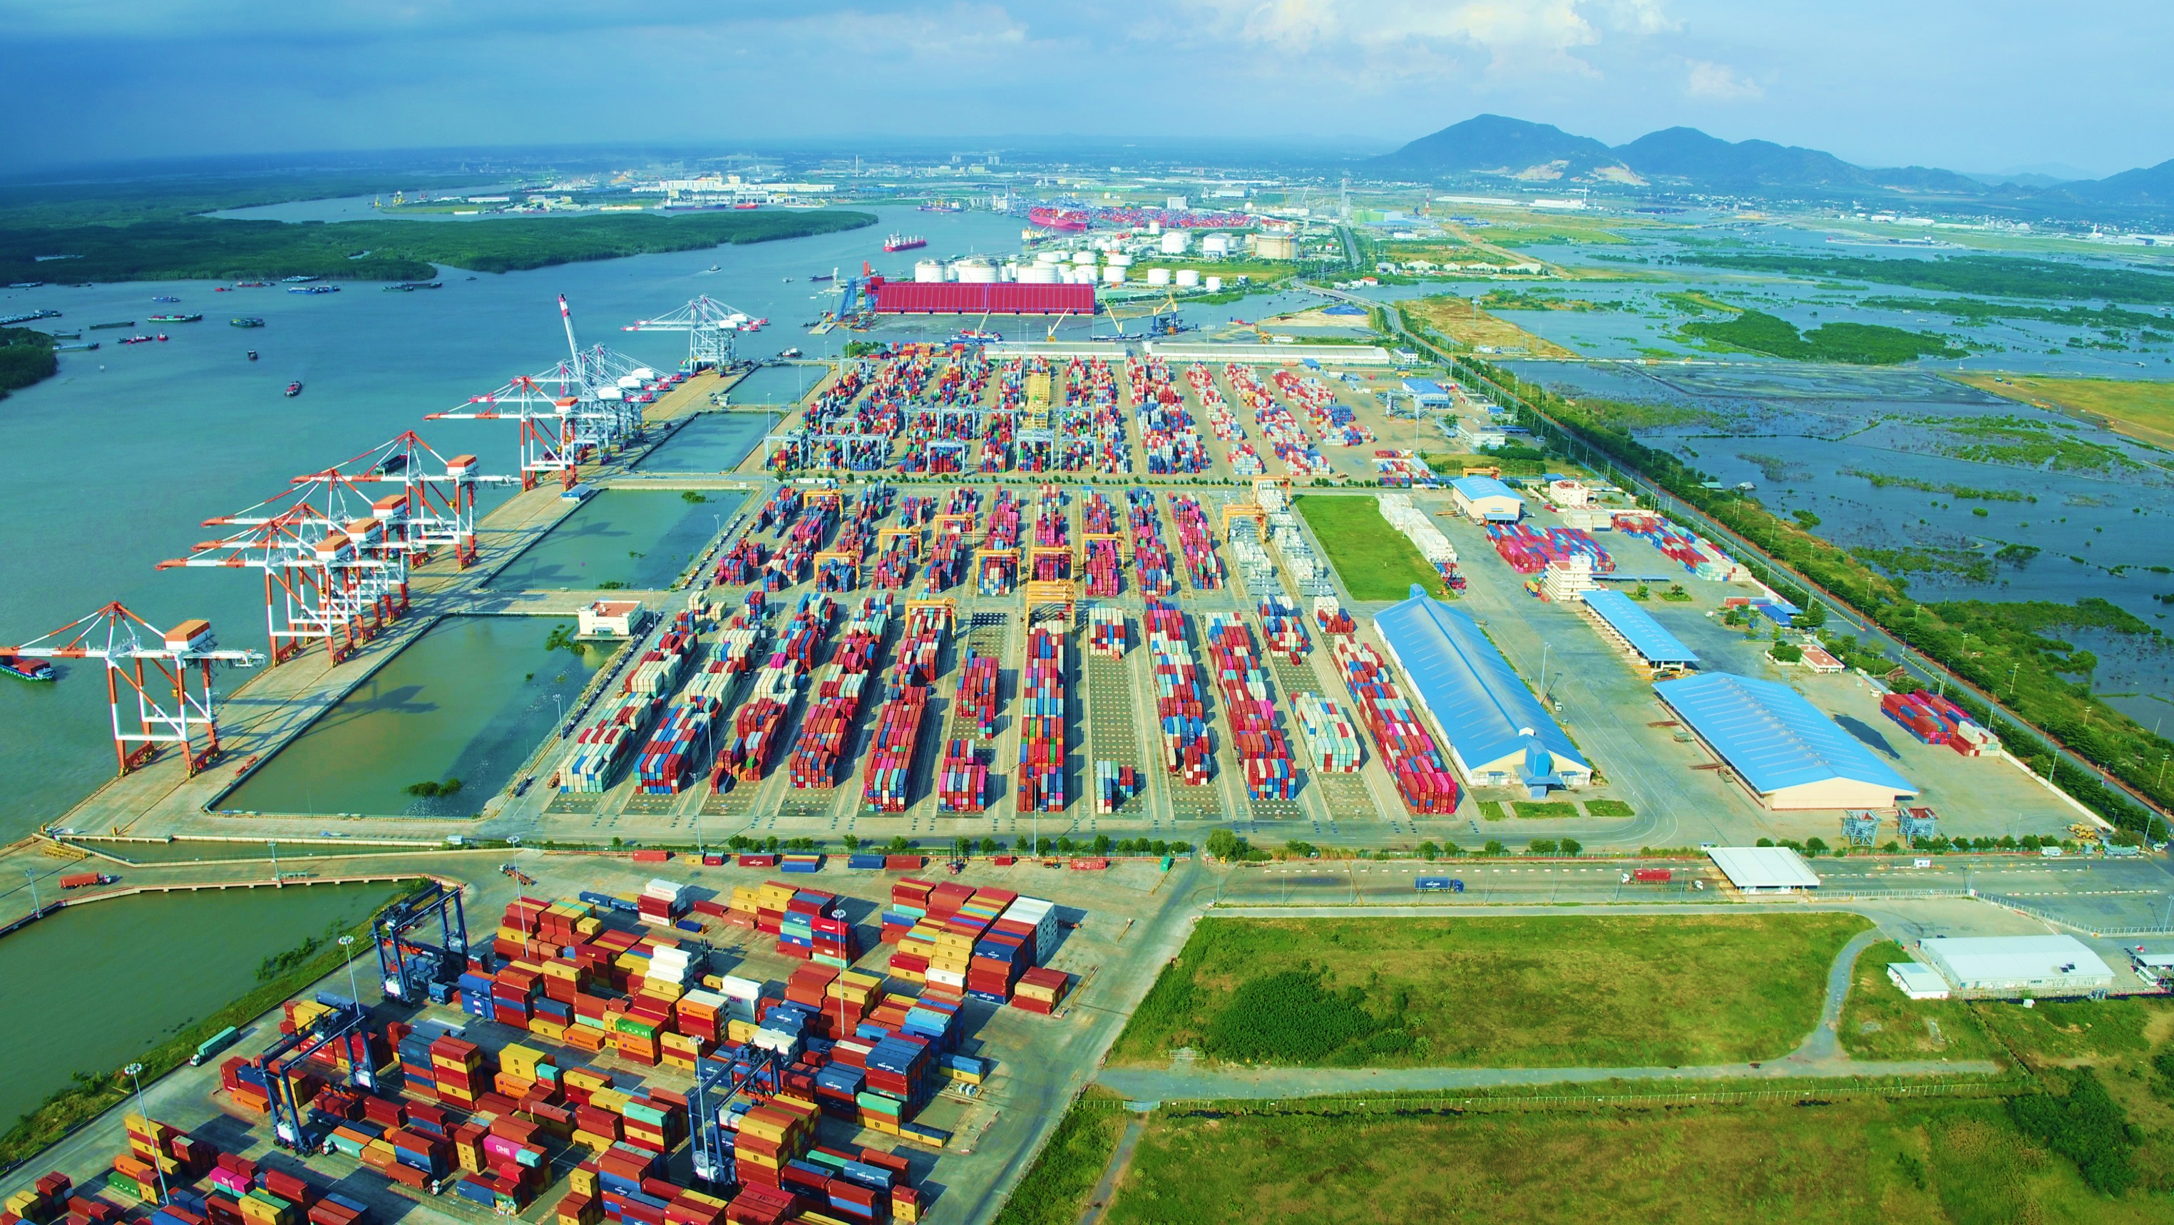
Port
Security Management System
e-Customs
WMS
e–Payment
VINACCS/VCIS
Notes:
Cùng với các công ty thành viên của TCT TCSG, TCTT đã liên tục đẩy mạnh số hóa các phần mềm giao nhận – thanh toán hiện đại
Giúp tiết kiệm thời gian và chi phí tối đa cho khách hàng.
Together with members of SNP, TCTT has continuously promoted the digitization of modern forwarding - payment software.
Help save maximum time and cost for customers.

Slide 17
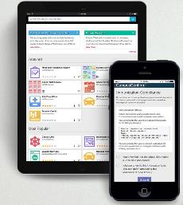
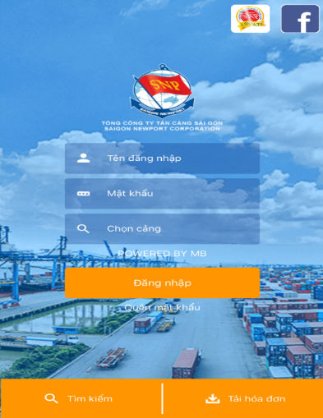
Technology
E-port via the internet and mobile device: 100% applicable for exported container from 01/04/2017 and imported container from 01/04/2018

Slide 18
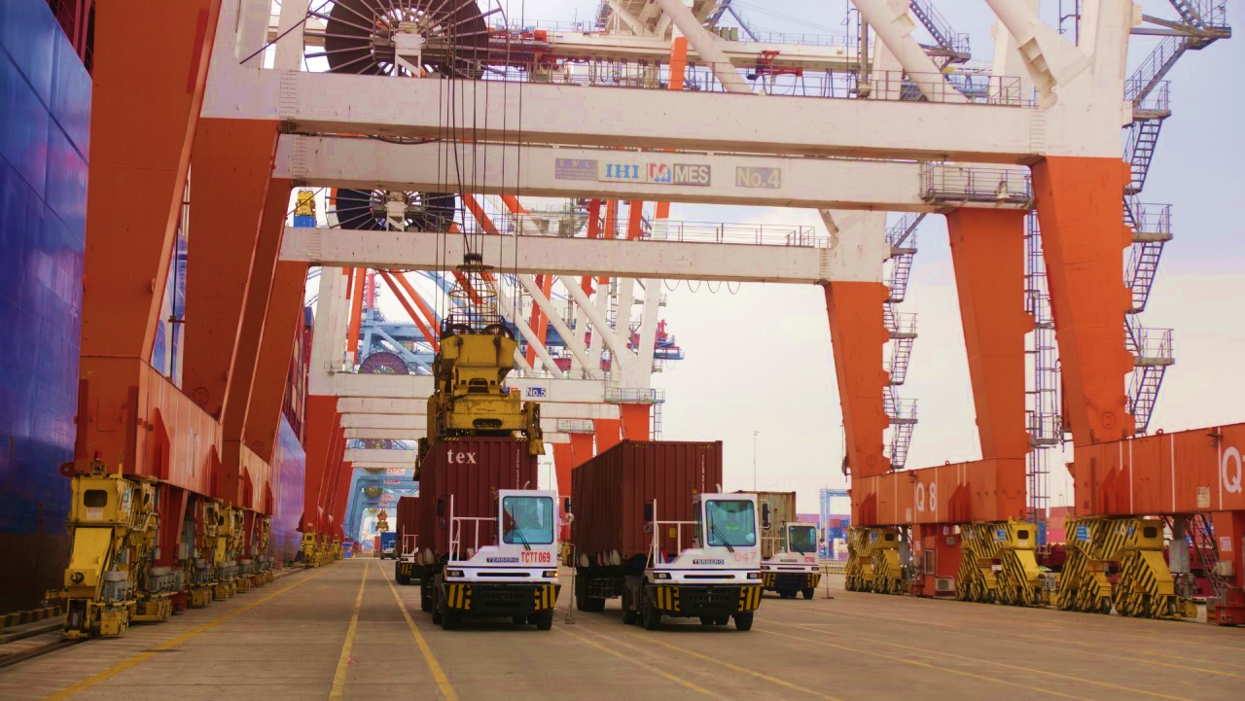
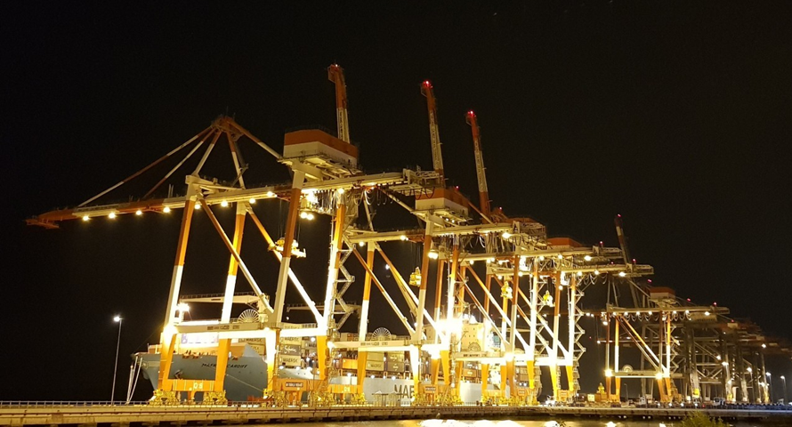
Business Activities
Operation of container vessel
Operation of cruise service.
Operation of general cargo vessel.
Operation of rigs and supply-base services, petroleum engineering

Slide 19
TAN CANG - CAI MEP THI VAI
THANK YOU!

